Slide 1
The Emotional Experience of Continuing Professional Development for Social Workers
Tanya Moore

Slide 2
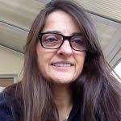
About me
SW Practitioner/learner/teacher/leader
Equally enjoy all 4

Slide 3
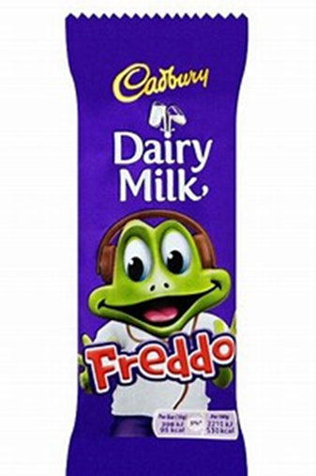
Why this research?
As an educator, I have seen social workers respond in very different ways to the invitation to learn and have been curious about why some CPD candidates connect and engage with offered learning while others remain less affected or even seemingly untouched by the experience.

Slide 4
Research questions
How do biographical influences affect our approach to CPD?
What internal conditions appear to impact our ability to engage with CPD?
How does it feel to learn?

Slide 5
What did I do?
‘As you know, I’m interested in exploring the emotional experience of CPD. So in this interview, I’m not going to interrupt or guide you in any way. I want to hear what you have to say and the connections you make. I’m inviting you to talk in whatever way you like about your experience of CPD, its impact on you and your development as a practitioner.’

Slide 6
limitations
Small study.
Obvious bias; these participants all enjoy CPD.

Slide 7
What did I find?
Q1 how do biographical influences affect our approach to CPD?
When talking about their experience of CPD, all participants also spoke about their childhood experiences.
This suggested to me the presence of an inner voice, perhaps that of a parent, that influences their approach to learning.
These voices are sometimes but not always helpful

Slide 8
Jackie
Jackie is a black SW. uni lecturer & doctoral student from east end of London.
Describes her family as working class but with higher standards.
School didn’t challenge and expected very little from her.
Jackie has 5 sisters and as teenagers, she says they related to the issues of hierarchy and status explored by Jane Austen in Pride and Prejudice.
.

Slide 9
Inner Voice
Jackie’s inner voice does not allow her to be a victim to racism. Instead, talks about her pride in the Saturday schools run by Caribbean churches
Standards in Saturday schools were high. Children expected to challenge themselves academically and socially
That message is deeply implanted in Jackie and remains as an inner voice

Slide 10
Q2 What internal conditions appear to impact our ability to engage with CPD?
Biographical influences create a relationship with education that influences the extent to which we take responsibility for our CPD.
So if as a child, learning was well supported and felt easy, this is likely to continue as an adult
But if learning was difficult as a child (because not valued/learning difficulty/overlooked etc), this difficult association with learning likely to continue as an adult

Slide 11
‘I think you have to take charge of your own development. I don’t think you can necessarily come into your role and expect your manager ….. to say ‘this is how we can develop you’. I think you need to come in knowing where you want to go.’
‘I told my son we do 10% learning in the class and 90% is what we do on our own …..’

Slide 12
Q3 How does it feel to learn?
The same way it did as when we were little.
Although not asked to do this, all the participants talked about their early family life and all of them talked about school.
The data suggests a strong connection between the way we feel when learning now and the way we felt when learning as children.

Slide 13
Q3 How does it feel to learn?
‘I found that the people I was being taught by as well, were again, committed to what they were doing. I don’t know if I’ve had a lovely experience, if I’ve got, you know, rose tinted glasses. But that’s what I’ve found, I’ve found that help was there if you looked for it.’

Slide 14
The Learning Response Model
Social workers’ experience of CPD is largely shaped by their early experiences of learning.
This isn’t surprising to anyone interested in psychodynamic thinking
But the extent to which early emotional experiences of learning are repeated when social workers learn as adults was not anticipated. The suggested process behind this is shown in the following model.

Slide 15
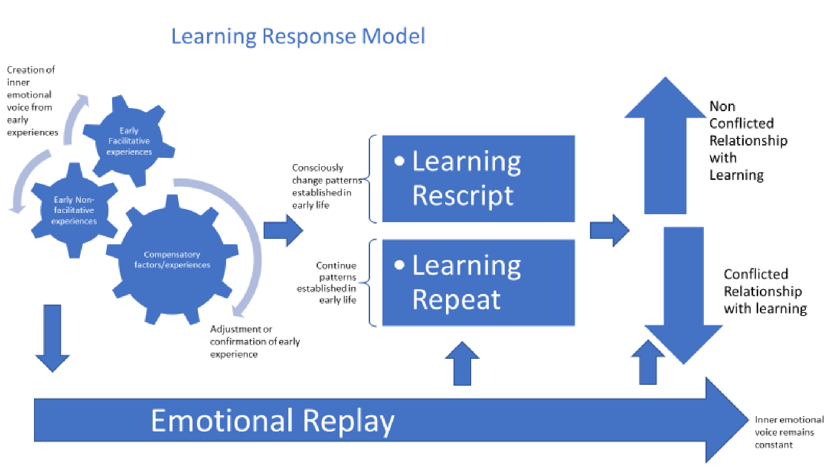

Slide 16
John

Slide 17
Tina

Slide 18
Thank you

